Slide 1
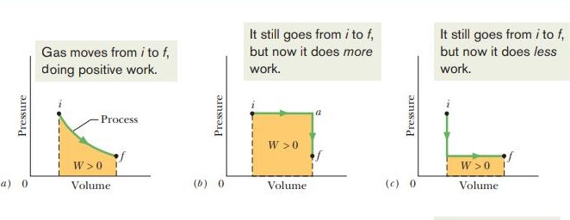
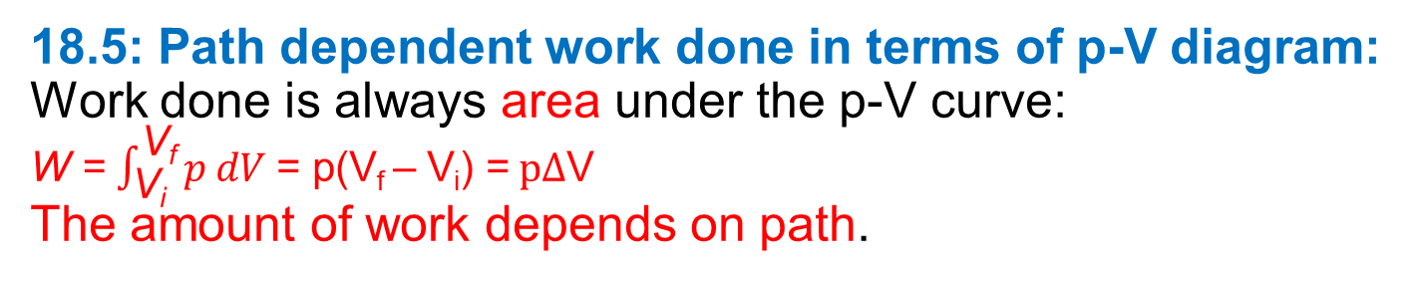
18.5: Path dependent work done in terms of p-V diagram: Work done is always area under the p-V curve: W = $\int_{\text{V}\text{i}}^{\text{V}\text{f}}{p dV}$= p(V_{f} – V_{i}) = $p∆$V The amount of work depends on path.
Lecture 3 Chapter 18: Temperature, heat and the first law of thermodynamics

Slide 2
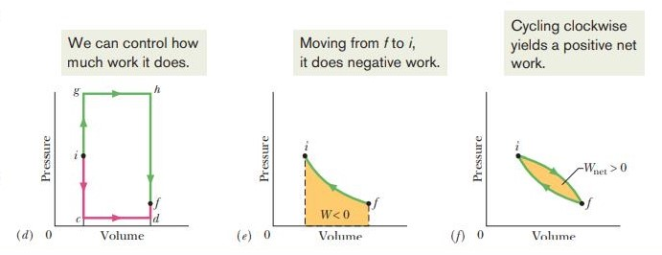

Slide 3
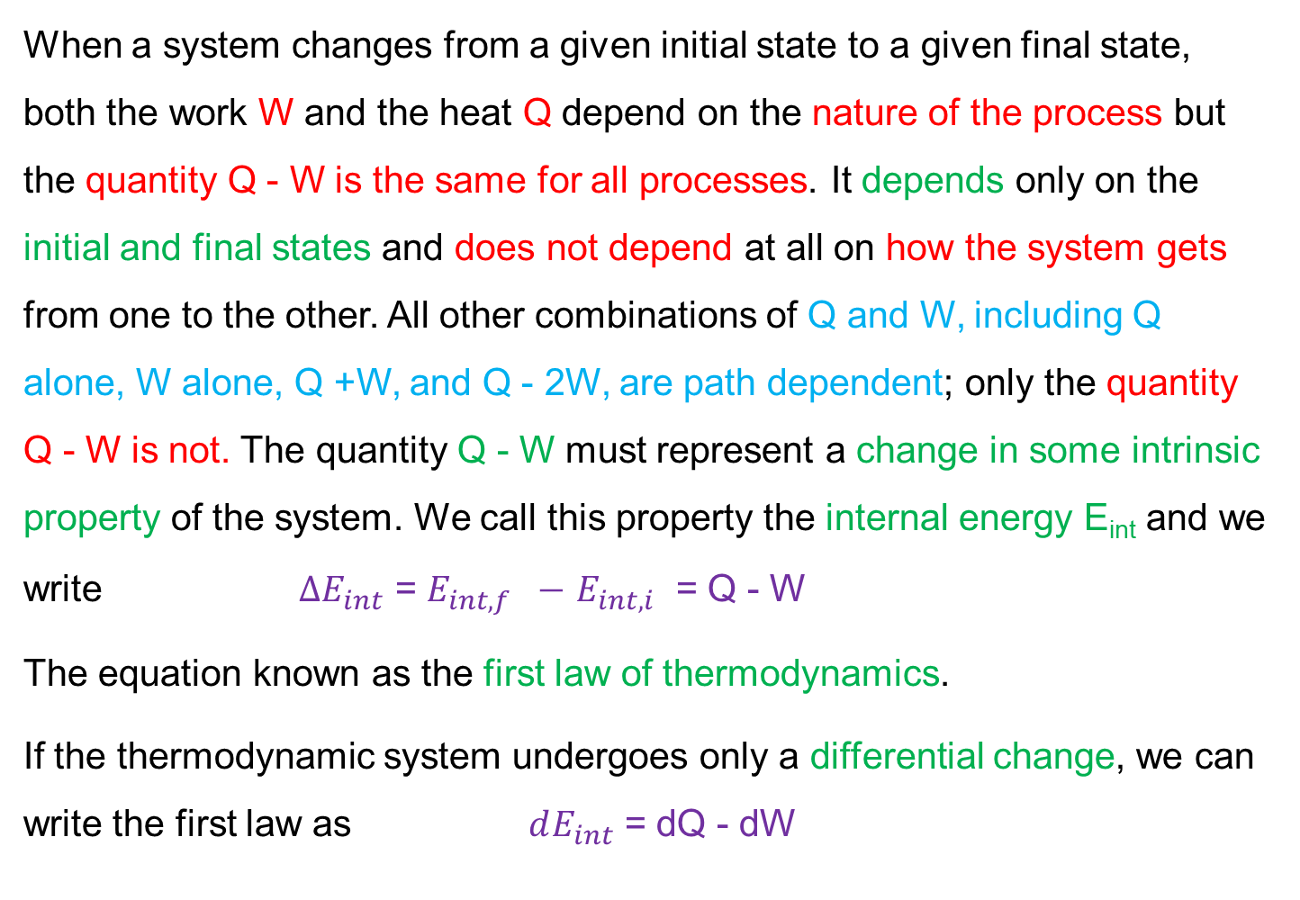
18.5: The First Law of Thermodynamics
When a system changes from a given initial state to a given final state, both the work W and the heat Q depend on the nature of the process but the quantity Q - W is the same for all processes. It depends only on the initial and final states and does not depend at all on how the system gets from one to the other. All other combinations of Q and W, including Q alone, W alone, Q +W, and Q - 2W, are path dependent; only the quantity Q - W is not. The quantity Q - W must represent a change in some intrinsic property of the system. We call this property the internal energy E_{int} and we write $∆E_{int}$ = $E_{int,f} −$ $E_{int,i}$ = Q - W
The equation known as the first law of thermodynamics.
If the thermodynamic system undergoes only a differential change, we can write the first law as $dE_{int}$ = dQ - dW

Slide 4
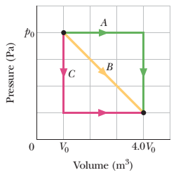
43. In Fig., a gas sample expands from V₀ to 4.0V₀ while its pressure decreases from p₀ to p₀/4.0. If V₀ = 1.0 m³ and p₀ = 40 Pa, how much work is done by the gas if its pressure changes with volume via (a) path A, (b) path B, and (c) path C?

Slide 5
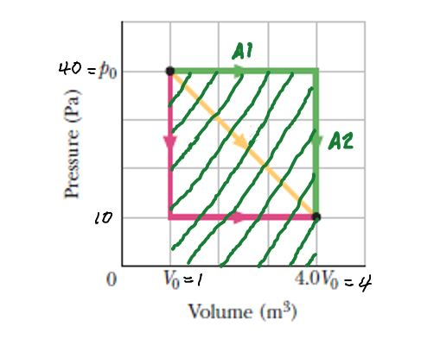
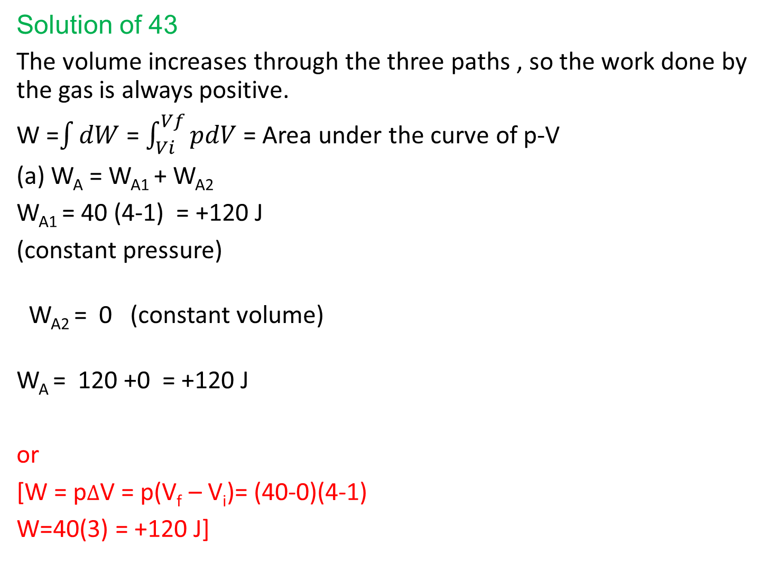
Solution of 43
The volume increases through the three paths , so the work done by the gas is always positive.
W =$\int{dW}$ = $\int_{Vi}^{Vf}{pdV }$= Area under the curve of p-V
(a) W_{A} = W_{A1} + W_{A2}
W_{A1} = 40 (4-1) = +120 J
(constant pressure)
W_{A2} = 0 (constant volume)
W_{A} = 120 +0 = +120 J
or
[W = p$∆$V = p(V_{f} – V_{i})= (40-0)(4-1)
W=40(3) = +120 J]

Slide 6
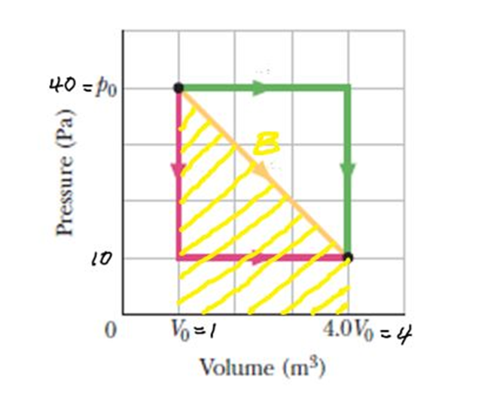
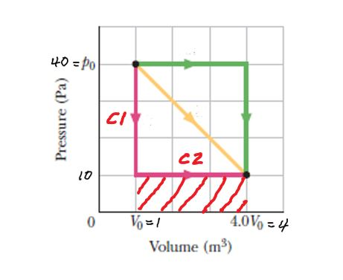
(b) The work done by the gas is the area
under the curve (yellow line)
W_{B}= ½ ×(4 - 1)(40 -10) + (4 -1)(10 - 0)
= (45 + 30) J
= +75 J
(c) W_{C}= W_{C1} + W_{C2}
W_{C1} = 0 (constant volume)
W_{C2} = (4-1)(10-0) = 30 J
W_{C} = 0 + 30 = +30 J

Slide 7
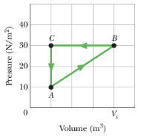
45. A gas within a closed chamber undergoes the cycle shown in the p-V diagram of Fig. The horizontal scale is set by V_{s} = 4.0 m³. Calculate the net energy added to the system as heat during one complete cycle.

Slide 8
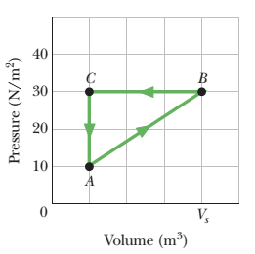
Solution:
Since for a closed cycle, ΔE_{int} = E - E = 0
1st law of thermodynamics, ΔE_{int} = Q - W
0 = Q - W
Q = W
The work done in a complete cycle is given
by the area inside the loop (triangle)
W_{net}= ½ × ( 4-1) (30-10) = 30 J
Area under the curve B to C ( compression)
Is greater than the area under the curve A
to B (expansion). So the net work done is
negative.
W _{net}= - 30 J
[or W_{net}= ½ × ( V_{f} - V_{i}) (30-10) =½ × ( 1-4) (30-10) = - 30 J]
Q = W = - 30 J
The gas (system) loses heat.

